Slide 1
Android Development
Hello Native Program

Slide 2
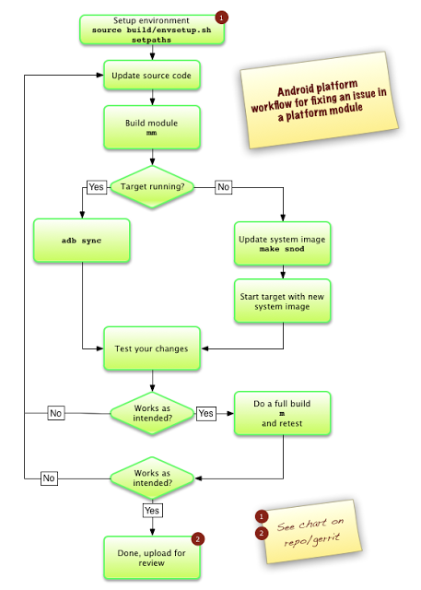
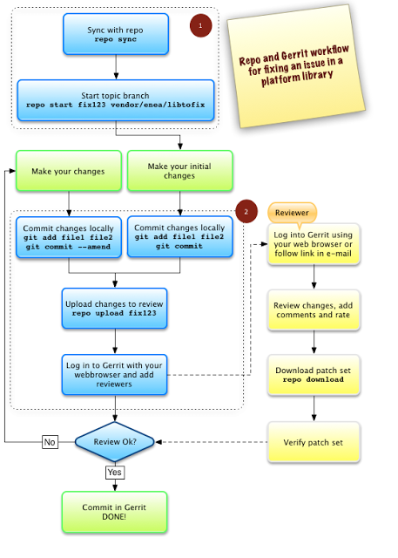
Android Open Source Project workflow

Slide 3
Hello Native Program
Precondition:
To install SDK and NDK
Requirements:
ENV preparation
Init build environment
Download the source (AOSP)
Build and Run
Add a New Program (refer to external/iputils)
Make a directory under ‘external’
Create your c/cpp files
Create Android.mk
run “mma” (refer to build/envsetup.sh)
adb root; adb remount;
adb push out/PATH/TO/PROGRAM /PATH/TO/PROGRAM
adb root; adb shell; cd PATH/TO/PROGRAM; PROGRAM
or
4. Back to root of source, and Make the source completely (Note: Build System build/core/main.mk will find the Android.mk)
adb root; adb remount; adb sync
adb root; adb shell; cd PATH/PROGRAM; PROGRAM

Slide 4
Hello Native Program
Delivery Date: Before 2014.11.28 6pm
Send your homework to
android.academy.bjtu@gmail.com
Format of mail subject as below:
[groupID|personalID][Full Name]Hello Native Program

